Slide 1


A Signal Within the Sediments: Using Biological Stoichiometry as a Potential Biosignature on Martian Sediments
Johnelle Gonzales
Christopher Doughty, Northern Arizona University
Arizona NASA Space Grant Consortium Symposium
April 23rd, 2022

Slide 2
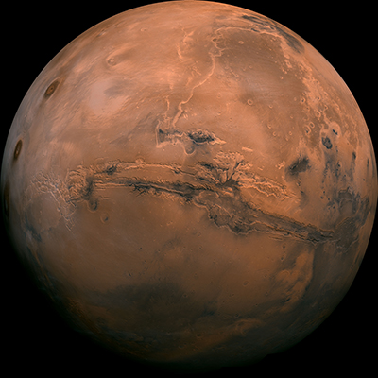
Background
Water once existed on Mars
Mudcracks
Could this water have harbored life?
Potential biosignatures on Mars?
https://mars.nasa.gov/

Slide 3
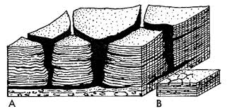
Purpose
Can we find a biosignature from microbial life?
Understanding distribution of bio-important vs non-bio-important elements across a surface
Leading hypothesis: life will follow changes in water
Depressions: top vs bottom
https://www.kgs.ku.edu/Publications/Bulletins/169/Fischer/index.html

Slide 4
Methods
Using an X-ray Fluorescence Spectrometer to measure elemental concentrations
Top vs bottom
Various sites for data collection:
Lab grown bio crusts
Grand Canyon
Moenkopi Formation from Northern Arizona site
Mars
Using machine learning techniques to analyze data

Slide 5
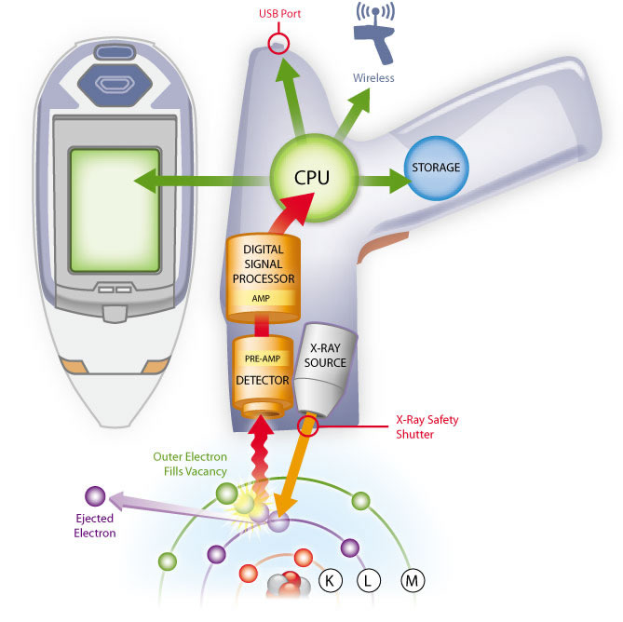
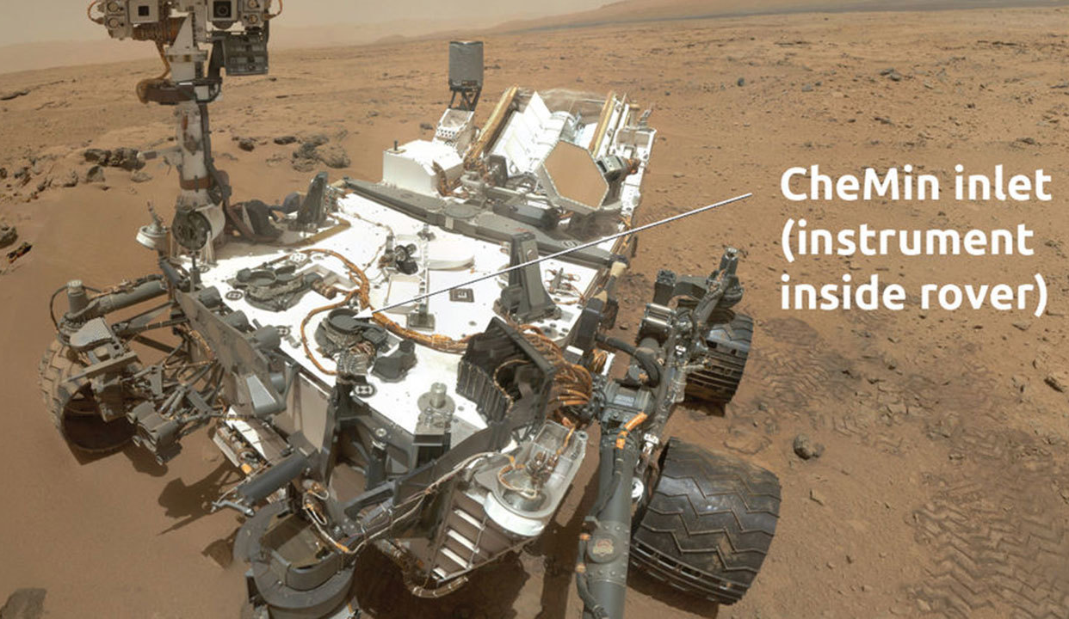
Instrumentation
Handheld XRF spectrometer
CheMin Instrument on Curiosity rover
Contains XRF
https://www.thermofisher.com/blog/mining/technology-focus-x-ray-fluorescence-xrf-in-mining/
https://mars.nasa.gov/msl/spacecraft/instruments/chemin/

Slide 6
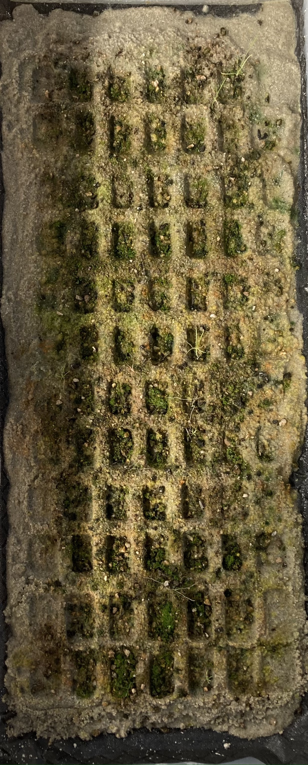
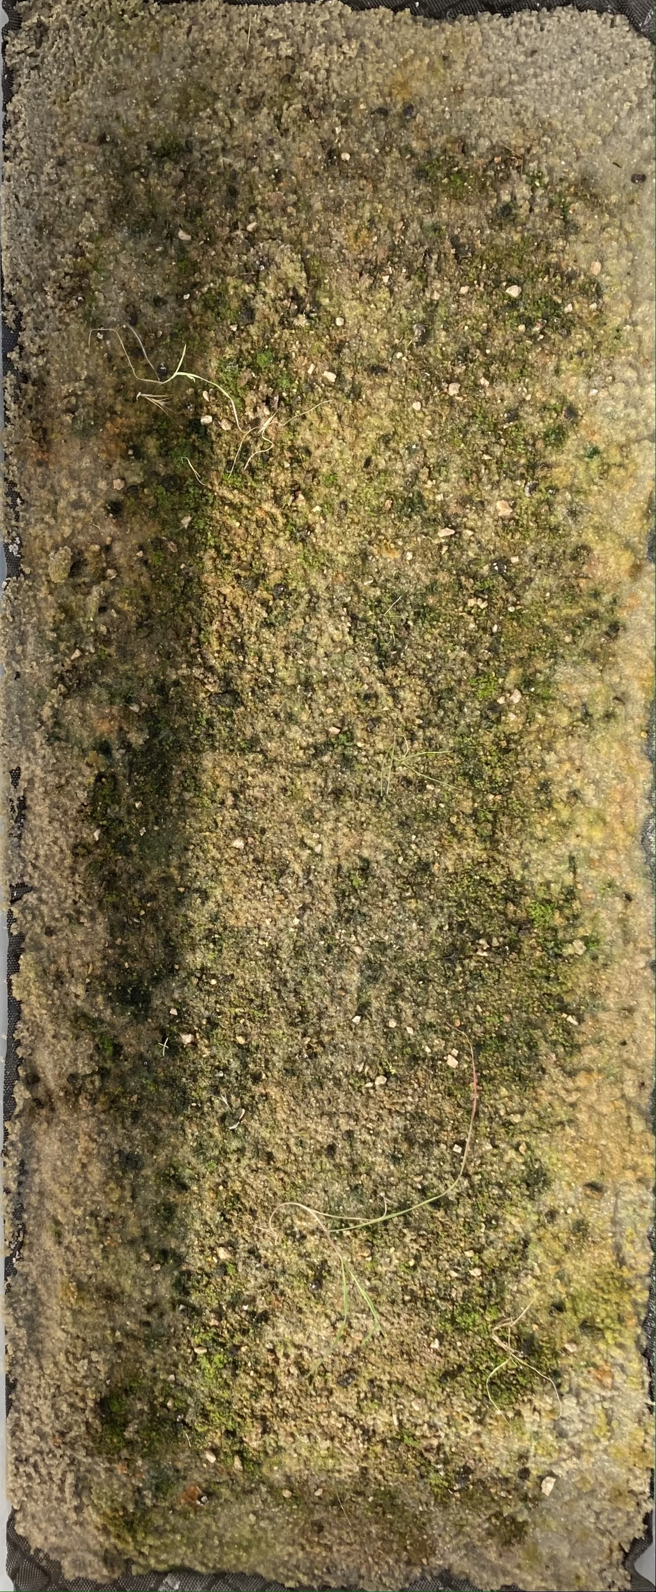
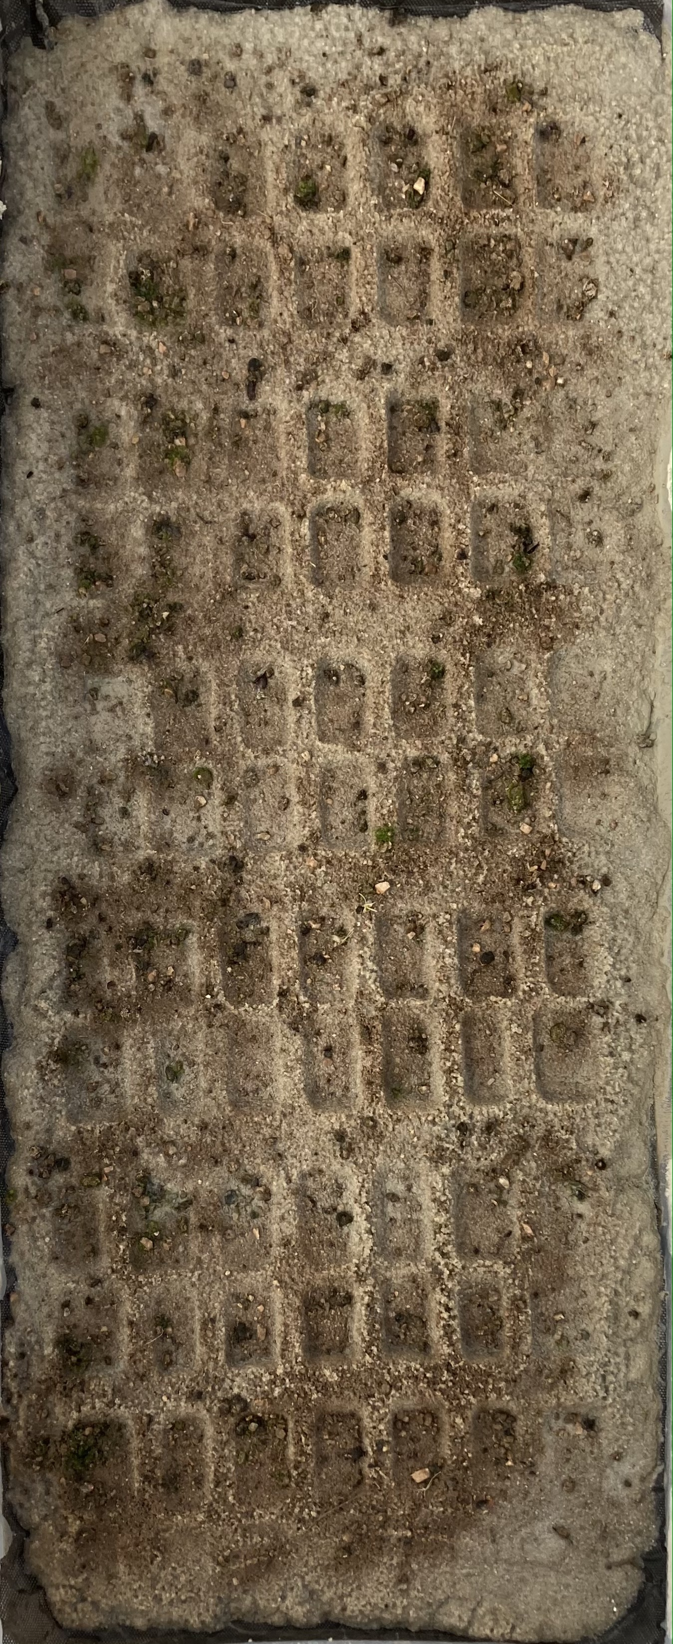
Biocrusts
Inoculant, Nutrients, and Depressions
Inoculant and Nutrients
Inoculant and Depressions

Slide 7
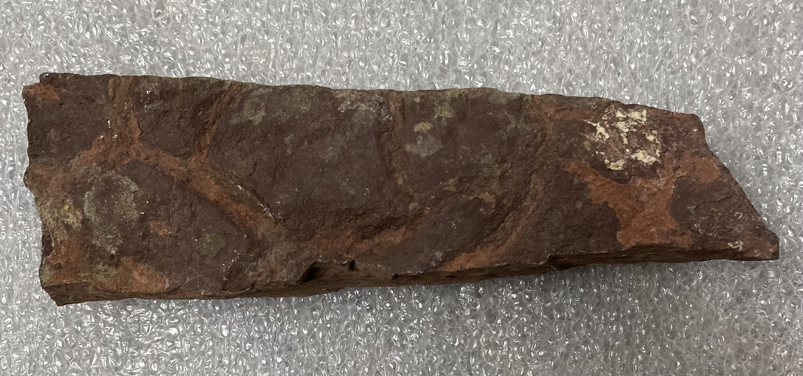
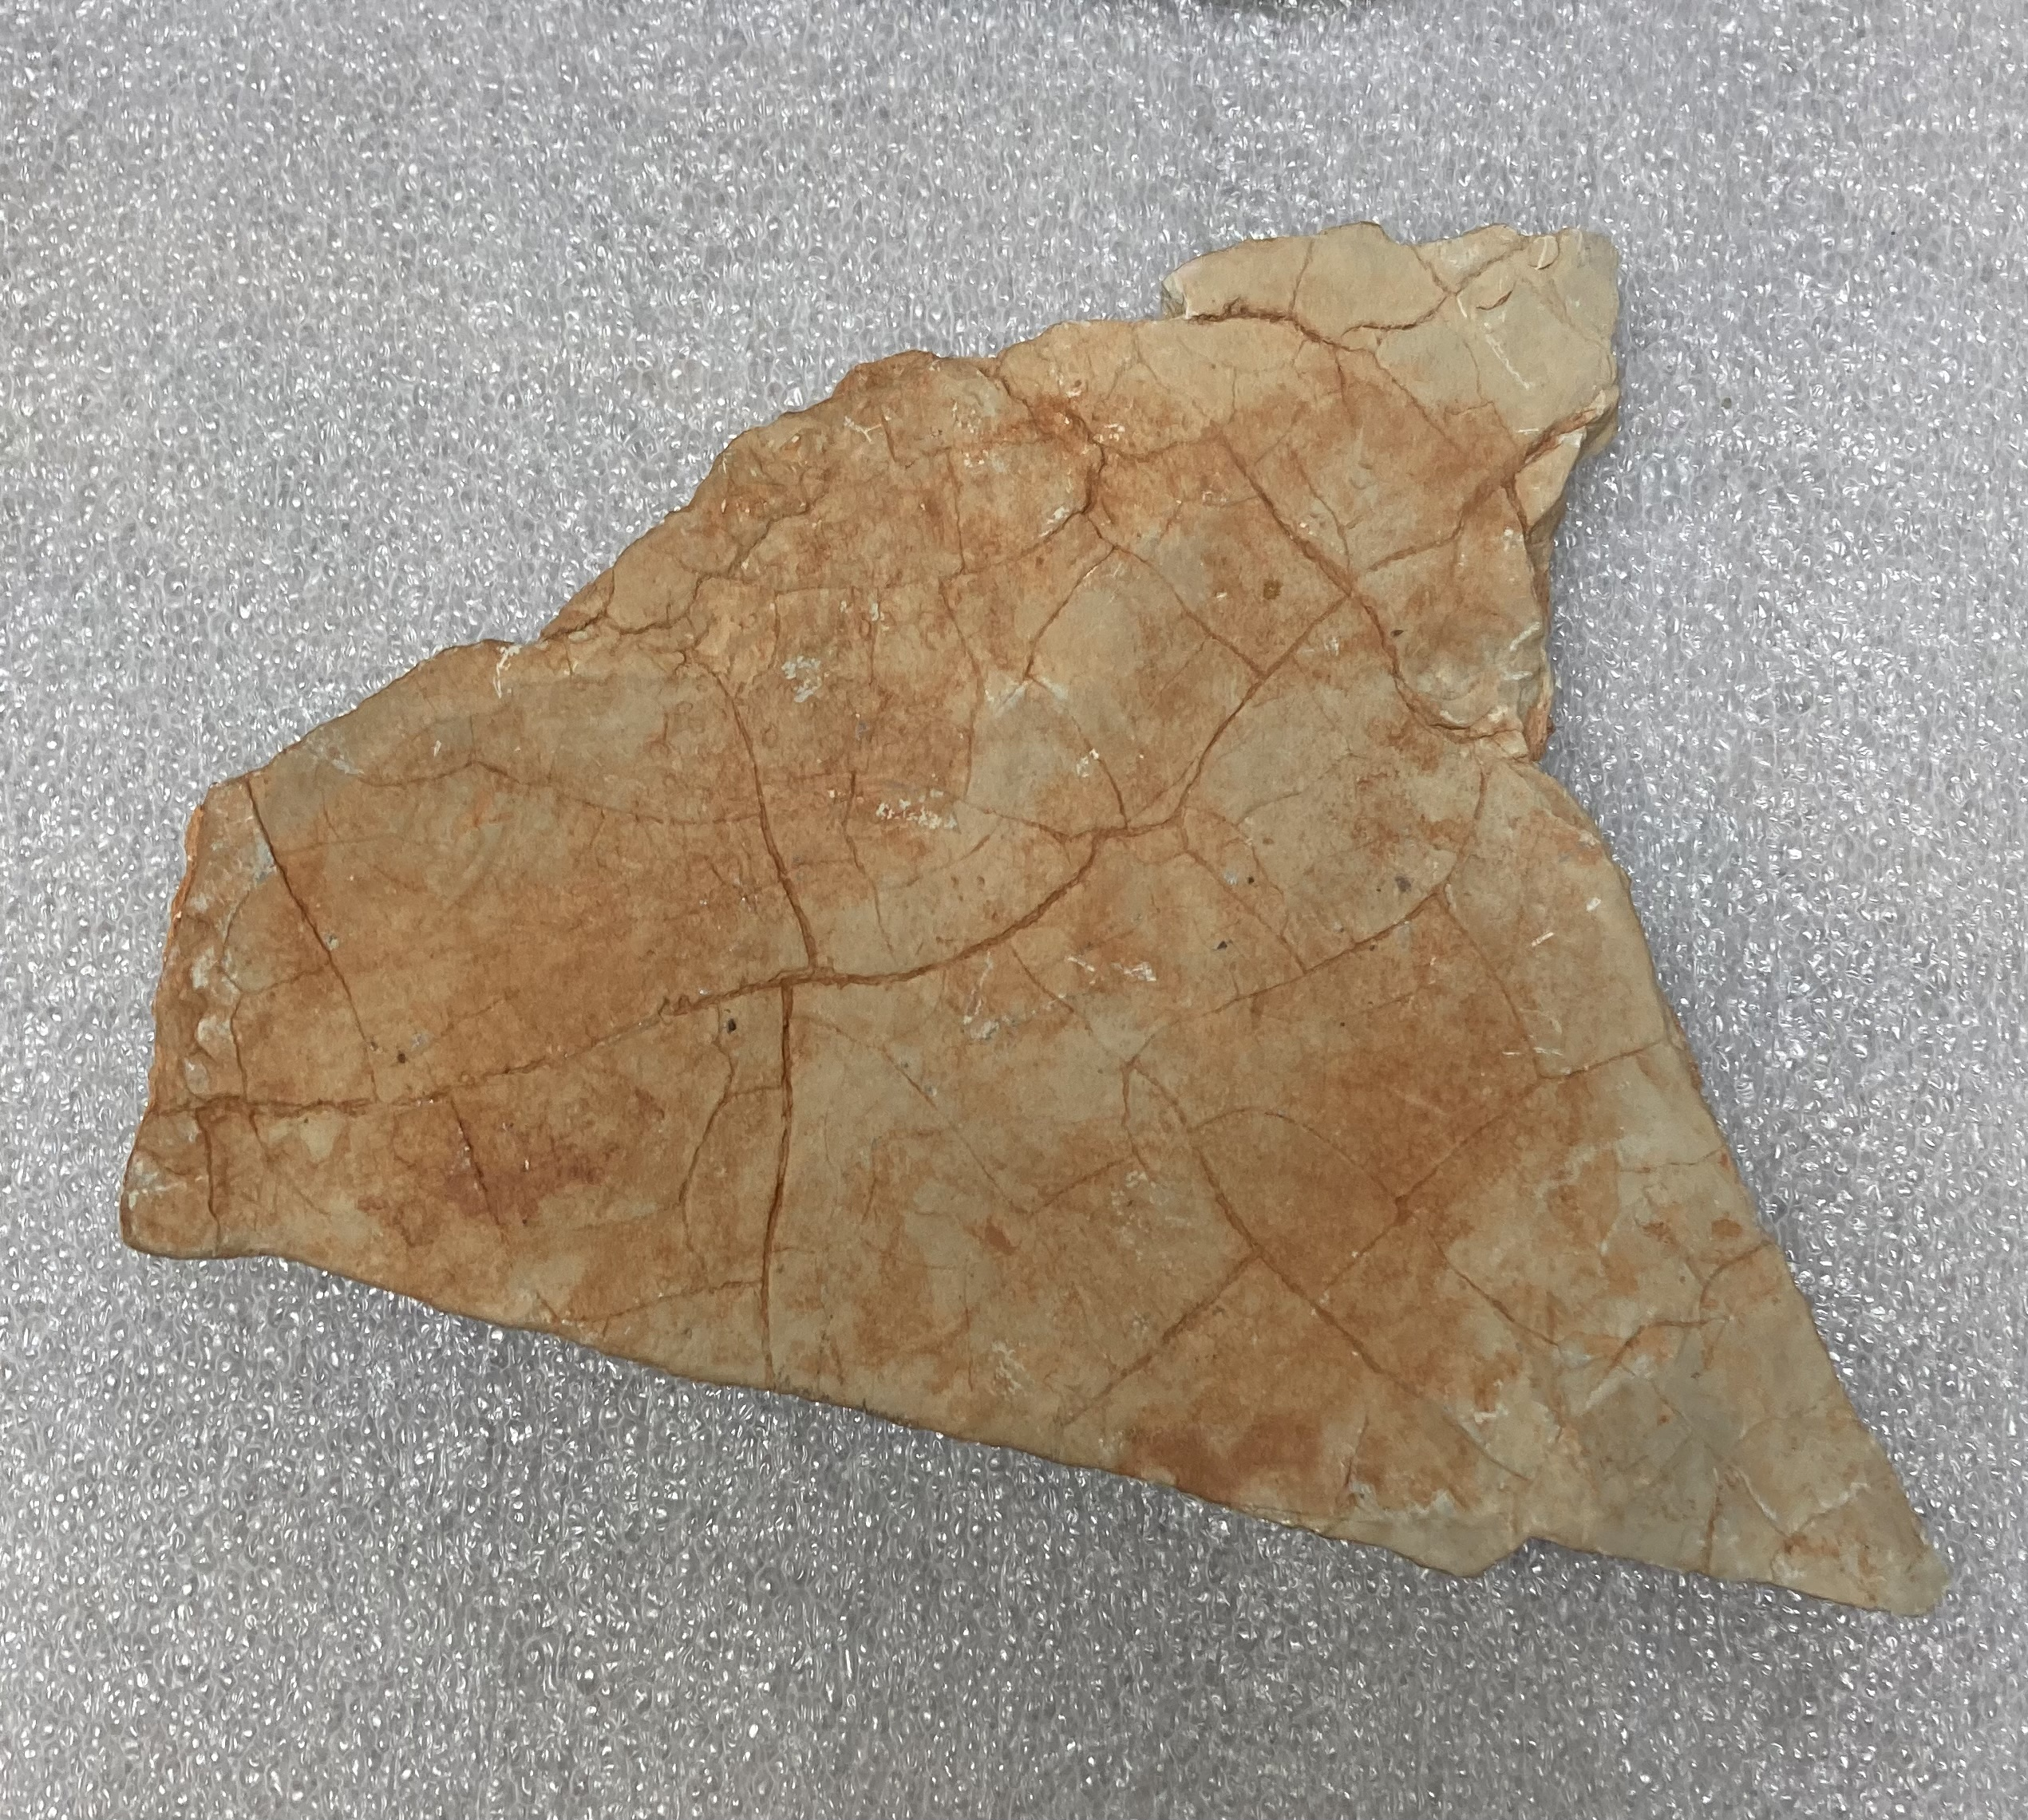
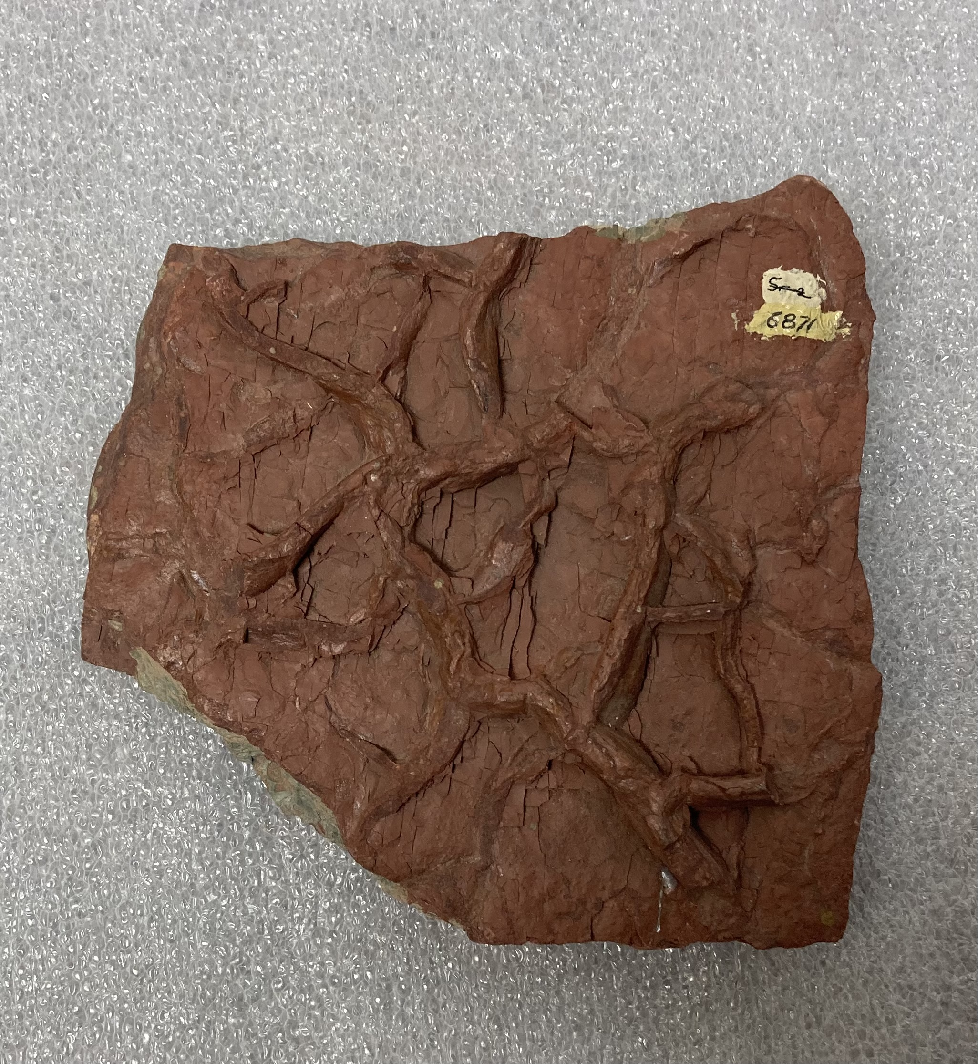
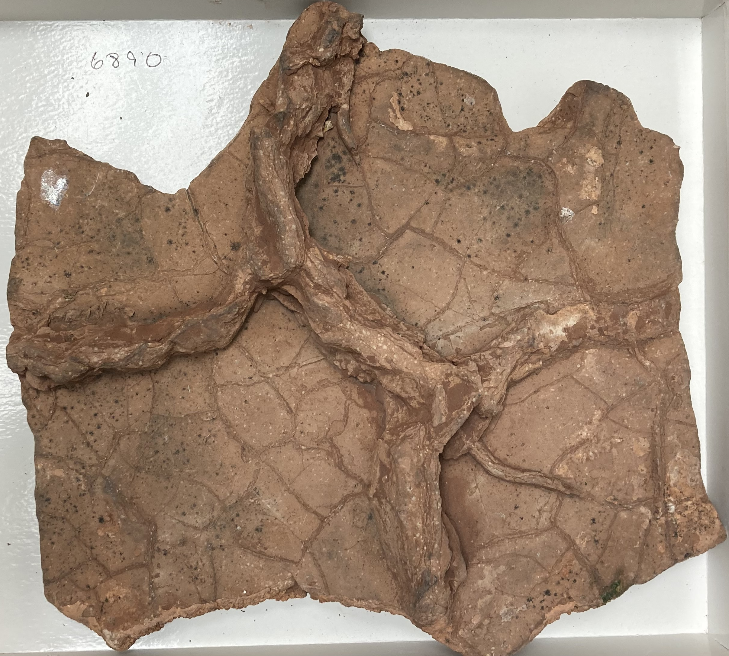
Grand Canyon

Slide 8
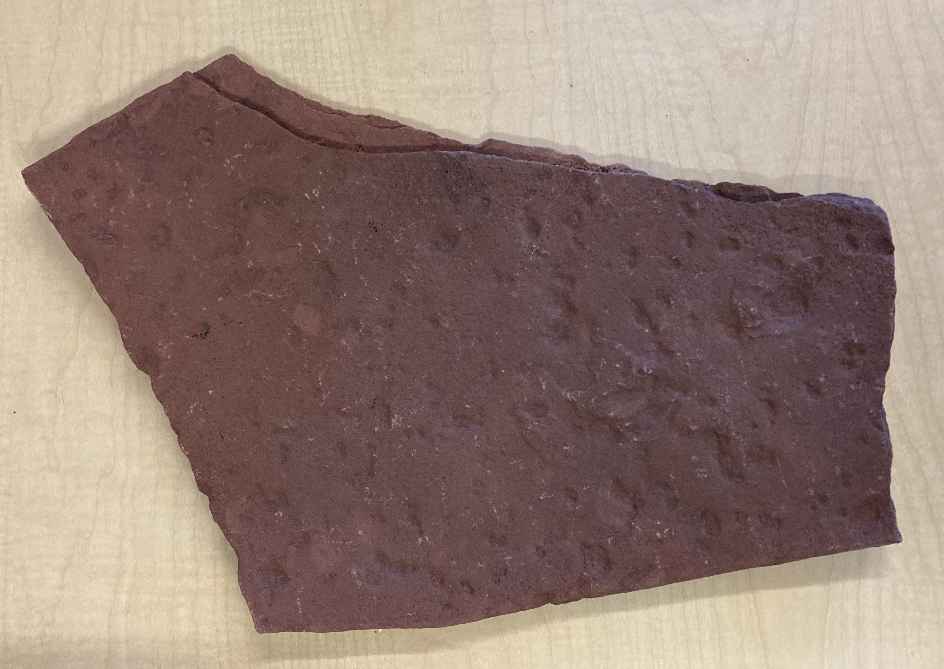
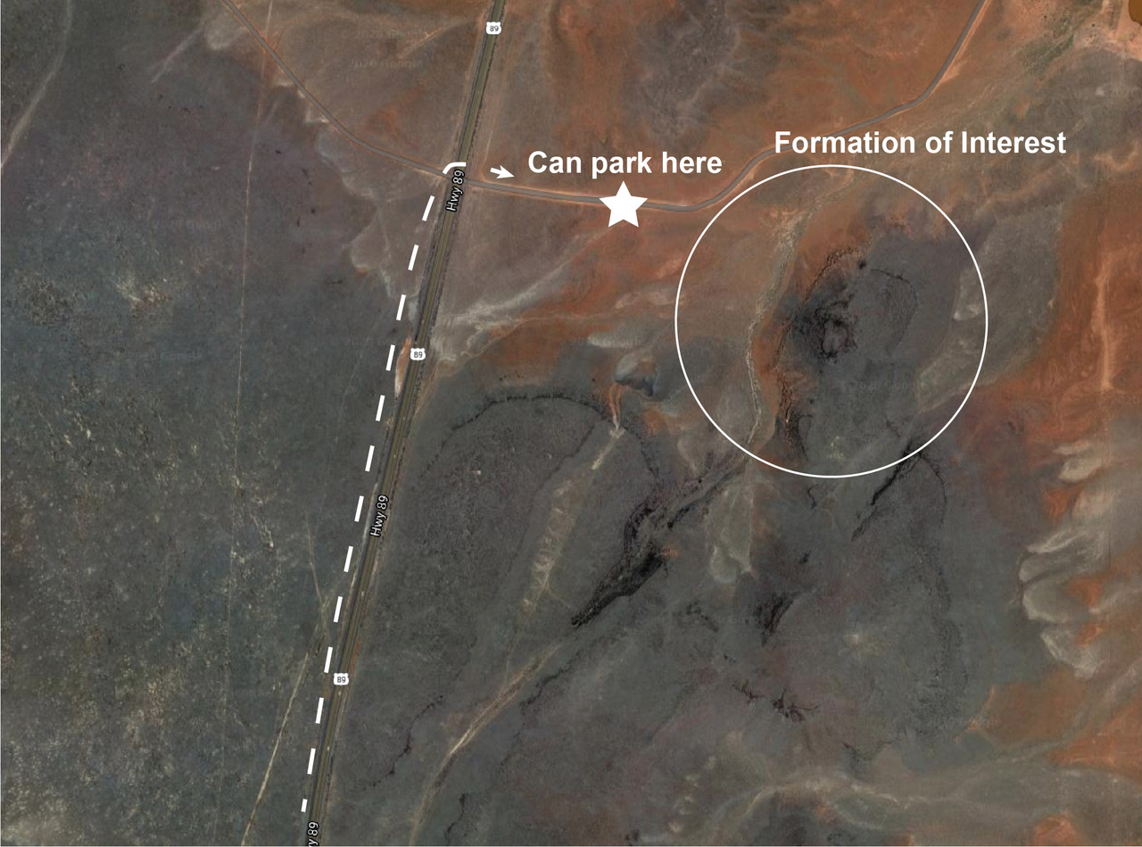
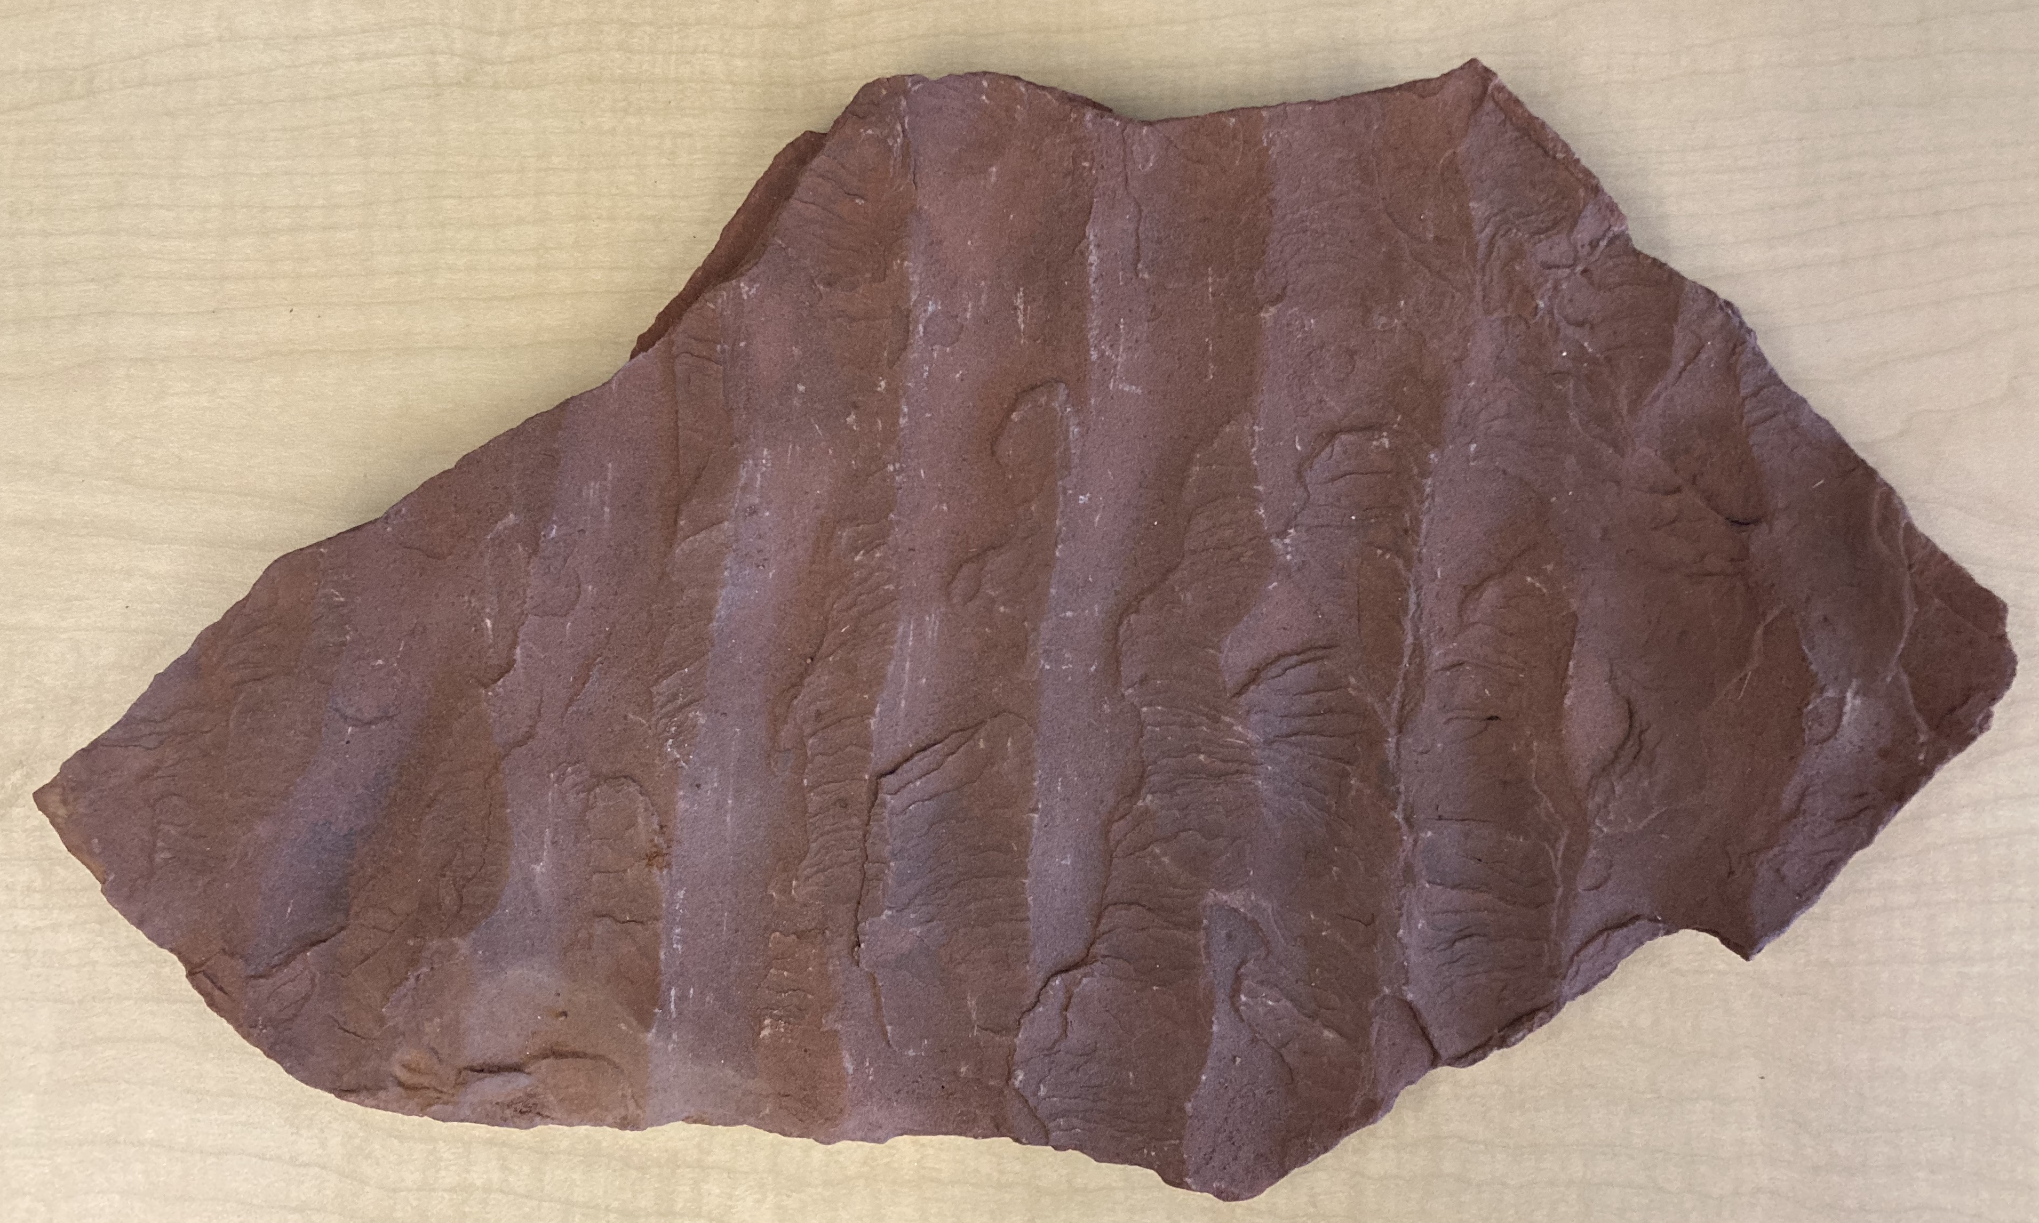
Moenkopi Formation

Slide 9
Preliminary Results
Elemental distributions of Al, S, and Mg from one grand canyon sample

Slide 10
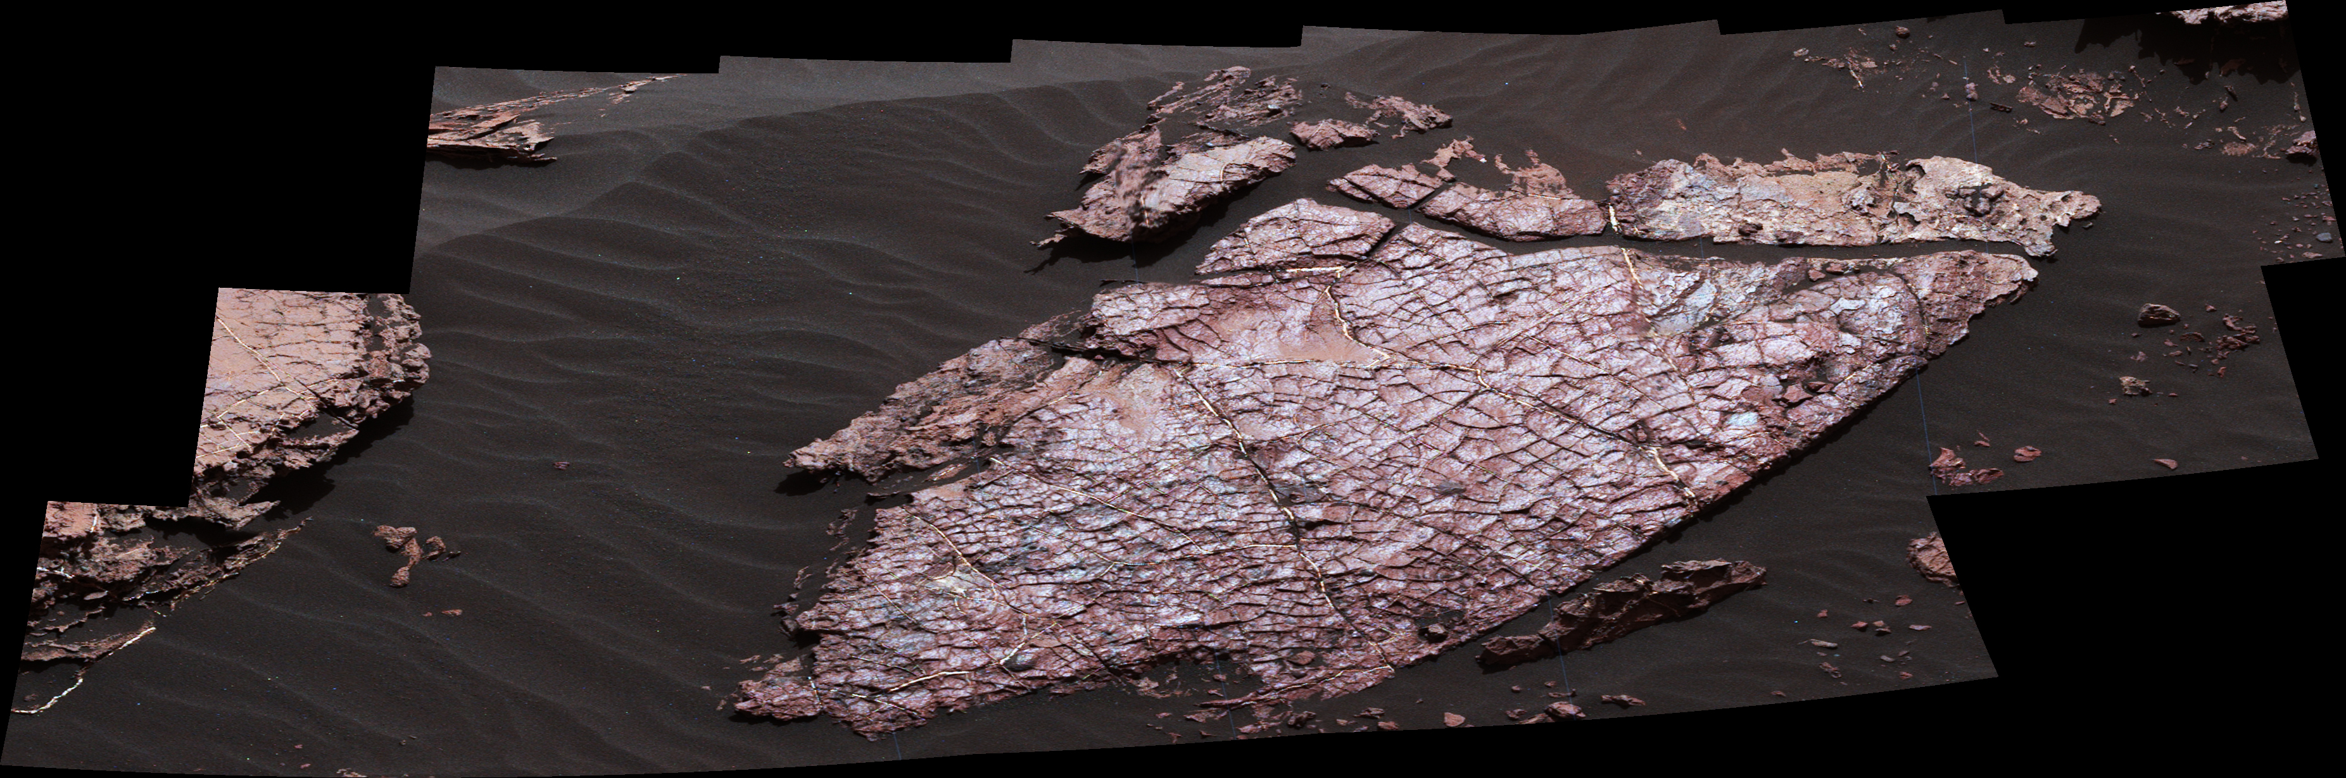
Next Steps
Use various machine learning techniques to extrapolate data
Observe patterns in distribution
Important elements
Compare our data to Mars!
Similar patterns?
Credits: NASA/JPL-Caltech/MSSS

Slide 11
Thank you!
Christopher Doughty
Andrew Abraham
Matthew Bowker
Valerie Payre
Mark Salvatore
Northern Arizona University
School of Informatics Computing and Cyber Systems
Department of Astronomy and Planetary Science
NASA Space Grant Consortium

